Slide 1
IT Infrastructure Architecture
Infrastructure Building Blocks
and Concepts
Security Concepts
(chapter 6)

Slide 2
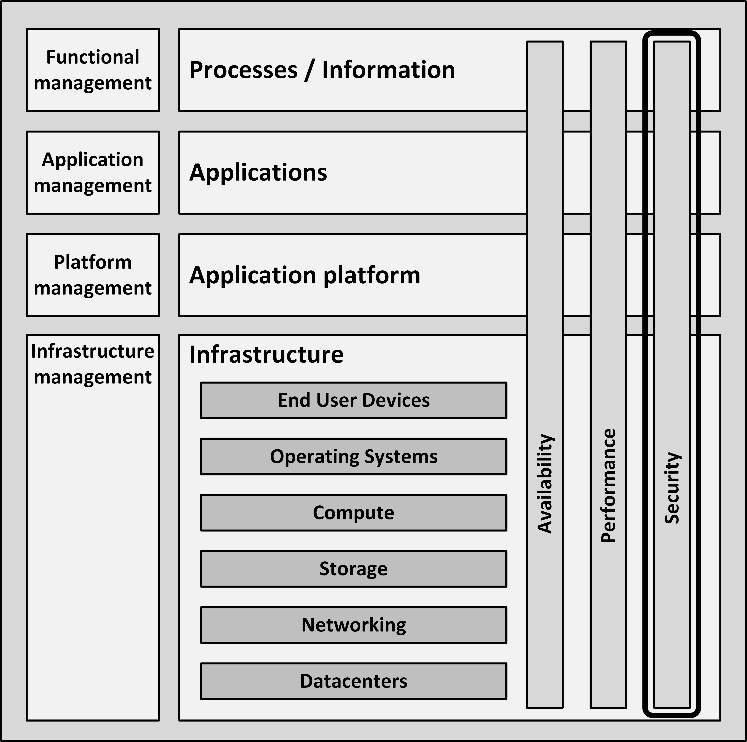
Introduction
Security is the combination of:
Availability
Confidentiality
Integrity
Focused on the recognition and resistance of attacks
For IT infrastructures availability is a non-functional attribute in its own right

Slide 3
Computer crimes
Reasons for committing crime against IT infrastructures:
Personal exposure and prestige
Creating damage
Financial gain
Terrorism
Warfare

Slide 4
Risk management

Slide 5
Risk management
Managing security is all about managing risks
The effort we put in securing the infrastructure should be directly related to the risk at hand
Risk management is the process of:
Determining an acceptable level of risk
Assessing the current level of risk
Taking steps to reduce risk to the acceptable level
Maintaining that level

Slide 6
Risk list
A risk list can be used to quantify risks
Risk is calculated based on:
Asset name - component that needs to be protected
Vulnerability - weakness, process or physical exposure that makes the asset susceptible to exploits
Exploit - a way to use one or more vulnerabilities to attack an asset
Probability - an estimation of the likelihood of the occurrence of an exploit
Impact - the severity of the damage when the vulnerability is exploited
Notes:
Proability: 1. Unlikely 2. Seldom 3. Occasional 4.Likely 5. Frequent
Impact: 1.Negligible 2.Moderate 3.Critical 4.Catastrophic

Slide 7
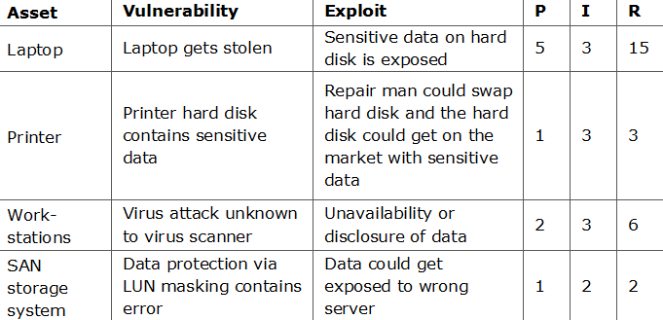
Risk list
P=Probability
I=Impact
R=Risk

Slide 8
Risk response
There four risk responses:
Acceptance of the risk
Avoidance of the risk - do not perform actions that impose risk
Transfer of the risk - for instance transfer the risk to an insurance company
Mitigation of the risk and accepting the residual risk

Slide 9
Exploits
Information can be stolen in many ways
Examples:
Key loggers can send sensitive information like passwords to third parties
Network sniffers can show network packages that contain sensitive information or replay a logon sequence
Data on backup tapes outside of the building can get into wrong hands
Disposed PCs or disks can get into the wrong hands
Corrupt or dissatisfied staff can copy information
End users are led to a malicious website that steals information (phishing)

Slide 10
CIA
Three core goals of security (CIA):
Confidentiality - prevents the intentional or unintentional unauthorized disclosure of data
Integrity - ensures that:
No modifications to data are made by unauthorized staff or processes
Unauthorized modifications to data are not made by authorized staff or processes
Data is consistent
Availability - ensures the reliable and timely access to data or IT resources by the appropriate staff

Slide 11
CIA
Example of confidentiality levels

Slide 12
CIA
Example of integrity levels

Slide 13
CIA
Example of availability levels

Slide 14
Security controls
Controls mitigate risks
Security controls must address at least one of the CIA
Information can be classified based on CIA levels
Controls can be designed and implemented based on the identified risk level for CIA

Slide 15
Security controls
Example

Slide 16
Attack vectors
Malicious code
Applications that, when activated, can cause network and server overload, steal data and passwords, or erase data
Worms
Self-replicating programs that spread from one computer to another, leaving infections as they travel
Virus
Self-replicating program fragment that attaches itself to a program or file enabling it to spread from one computer to another, leaving infections as it travels
Trojan Horse
Appears to be useful software but will actually do damage once installed or run on your computer

Slide 17
Attack vectors
Denial of service attack
An attempt to overload an infrastructure to cause disruption of a service
Can lead to downtime of a system, disabling an organization to do its business
In a Distributed Denial of Service (DDoS) attack the attacker uses many computers to overload the server
Groups of computers that are infected by malicious code, called botnets, perform an attack

Slide 18
Attack vectors
Preventive DDoS measures:
Split business and public resources
Move all public facing resources to an external cloud provider
Setup automatic scalability (auto scaling, auto deployment) using virtualization and cloud technology
Limit bandwidth for certain traffic
Lower the Time to Live (TTL) of the DNS records to be able to reroute traffic to other servers when an attack occurs
Setup monitoring for early detection

Slide 19
Attack vectors
DDoS countermeasures:
Immediately inform your internet provider and ask for help
Run a script to terminate all connections coming from the same source IP address if the number of connections is larger than ten
Change to an alternative server (with another IP address)
Scale-out the public facing environment under attack
Reroute or drop suspected traffic

Slide 20
Attack vectors
Social engineering
Social skills are used to manipulate people to obtain information which can be used in an attack
Like passwords or other sensitive information
By nature, people want to help other people

Slide 21
Attack vectors
Phishing
A technique of obtaining sensitive information
The phisher sends an e-mail that appears to come from a legitimate source, like a bank or credit card company, requesting "verification" of information
The e-mail usually contains a link to a fraudulent web page

Slide 22
Attack vectors
Baiting
Baiting uses physical media, like an USB flash drive, left to be found
It relies on the curiosity of people to find out what is on it
The attacker hopes some employee picks up the device and brings it inside the organization
When the device is put into an organization owned PC, malicious software is installed automatically

Slide 23
Security Patterns

Slide 24
Identity and Access Management (IAM)
The process of managing the identity of people and systems, and their permissions
The IAM process follows three steps:
Users or systems claim who they are: identification
The claimed identity is checked: authentication
Permissions are granted related to the identity and the groups it belongs to: authorization

Slide 25
Identity and Access Management (IAM)
Single Sign-On (SSO):
A user logs in once and is passed seamlessly, without an authentication prompt, to SSO enabled applications
Can be implemented using identity providing systems
LDAP
Kerberos
Microsoft Active Directory
Users authenticate to these identity providers
Applications trust the identity provider, so they allow access when a user is authenticated

Slide 26
Identity and Access Management (IAM)
Federated identity management:
Extends SSO above the enterprise level
Creates a trusted identity provider across organizations
Participating organizations share identity attributes based on agreed-upon standards

Slide 27
Authentication
Using one of three ways:
Something you know, like a password or PIN
Something you have, like a bank card, a token or a smartphone
Something you are, like a fingerprint or an iris scan
Multi-factor authentication:
At least two types of authentication are required

Slide 28
Role Based Access Control (RBAC)
In RBAC, instead of granting permissions to individual identities, groups are granted permissions
Identities are members of one or more groups
Groups are related to their roles in the organization
Groups can be nested (a group is member of another group)
RBAC is used in almost all organizations

Slide 29
Segregation of duties and least privilege
Segregation of duties (also known as separation of duties):
Assigns related sensitive tasks to different people or departments
No single person has total control of the system’s security mechanisms
Least privilege:
Users of a system should have the lowest level of privileges necessary to perform their work
Users should only have privileges for the shortest length of time

Slide 30
Segregation of duties and least privilege
In secure systems, multiple distinct administrative roles should be configured:
Security manager
Systems manager
Super user
A two-man control policy can be applied
Two systems managers must review and approve each other’s work
Two systems managers are needed to complete every security sensitive task

Slide 31
Layered security
Layered security (also known as a Defense-In-Depth strategy) implements various security measures in various parts of the IT infrastructure
Instead of having one big firewall and have all your security depend on it, it is better to implement several layers of security
Preferably security layers make use of different technologies
This makes it harder for hackers to break through all barriers, as they will need specific knowledge for each step
Disadvantage: increases the complexity of the system

Slide 32
Cryptography
The practice of hiding information using encryption and decryption techniques
Encryption is the conversion of information from a readable state to apparent random data
Only the receiver has the ability to decrypt this data, transforming it back to the original information
A cipher is a pair of algorithms that implements the encryption and decryption process
The operation of a cipher is controlled by a key

Slide 33
Cryptography
Block ciphers
Input:
A block of plaintext
A key
Output:
A block of cipher text
Used across a wide range of applications, from ATM machine data encryption to e-mail privacy and secure remote access
Standards:
Data Encryption Standard (DES)
Advanced Encryption Standard (AES)

Slide 34
Cryptography
Stream ciphers
Create an arbitrarily long stream of key material
Combines key stream with the plaintext bit-by-bit or character-by-character
Used when data is in transit over the network
RC4 is a widely-used stream cipher

Slide 35
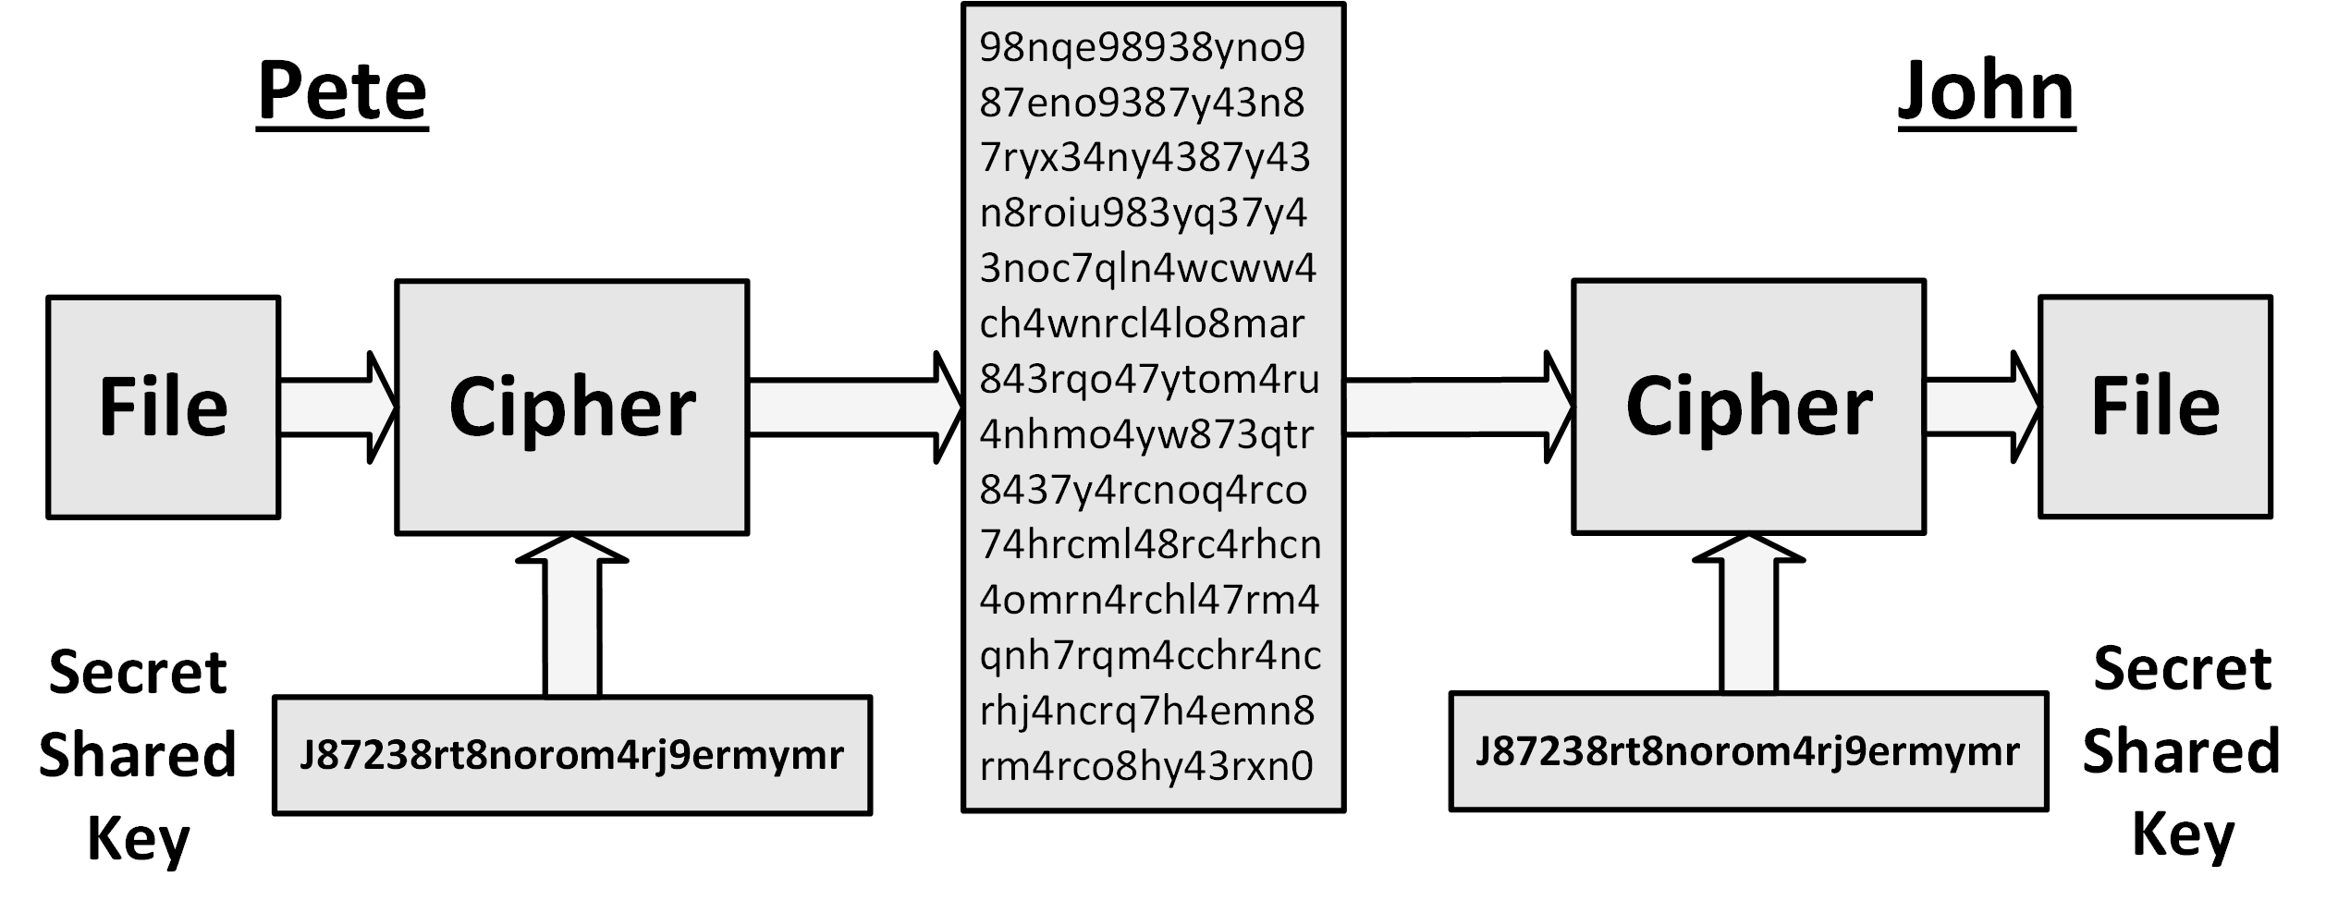
Symmetric key encryption
Both the sender and receiver share the same key

Slide 36
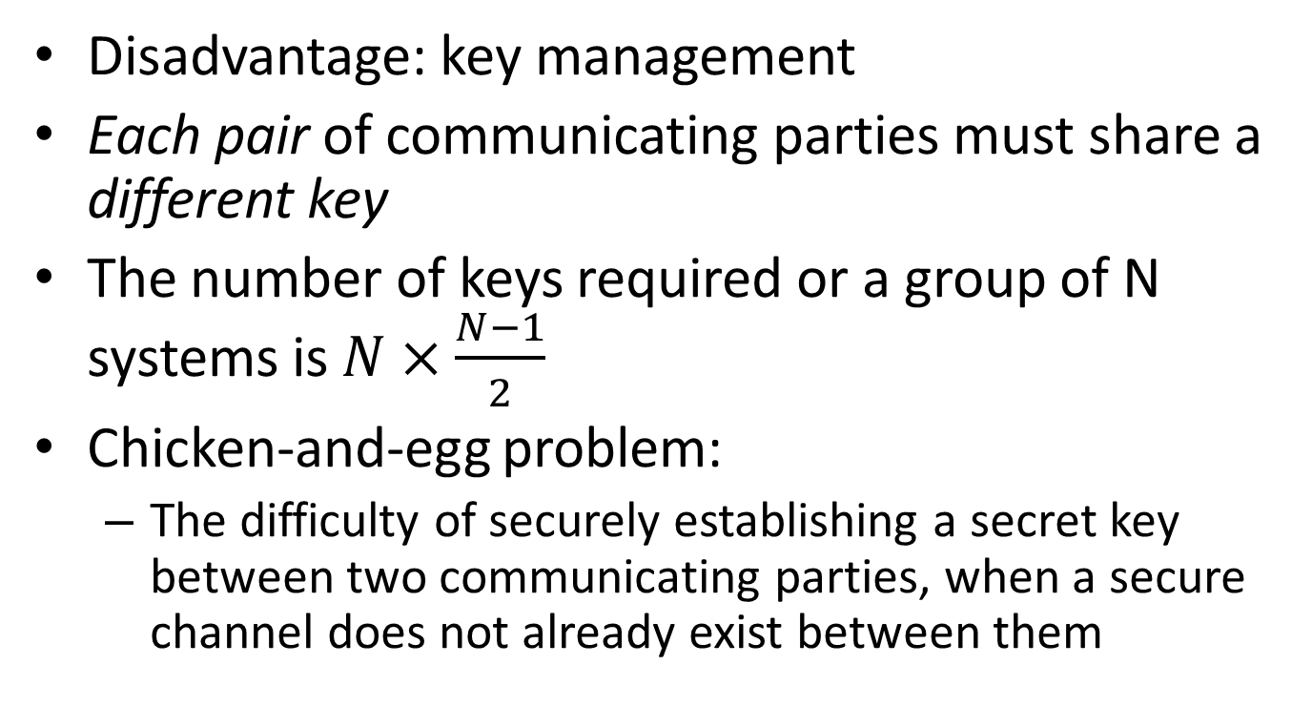
Symmetric key encryption
Disadvantage: key management
Each pair of communicating parties must share a different key
The number of keys required or a group of N systems is $N×\frac{N−1}{2}$
Chicken-and-egg problem:
The difficulty of securely establishing a secret key between two communicating parties, when a secure channel does not already exist between them

Slide 37
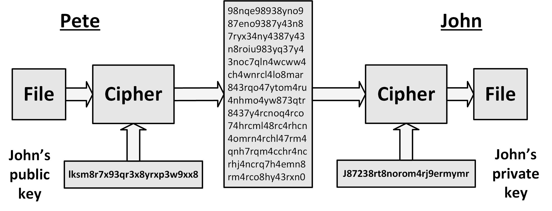
Asymmetric key encryption
Two different but mathematically related keys are used: a public key and a private key

Slide 38
Asymmetric key encryption
Two different but mathematically related keys are used:
a public key - may be freely distributed
a private key - must remain secret by the organization
Diffie–Hellman and RSA algorithms are the most widely used algorithms
Disadvantage: slow
About 1000 to 10,000 times slower than symmetric key encryption

Slide 39
Asymmetric key encryption
Mostly used to setup a channel between two parties, to safely exchange a new, temporary symmetric key
Pete creates a random secret key and encrypts it using the public key from John
The encrypted secret key is sent to John using an open channel (like the internet)
John is the only party that can decrypt the message, because he has the private key that is related to the public key. John decrypts the message and now knows the secret key
Pete and John start communicating using symmetric key encryption, using the exchanged secret key
When the communication is finished, the shared key is no longer valid and is deleted

Slide 40
Hash functions
Hash functions take some piece of data, and output a short, fixed length text string (the hash)
The hash is unique for that piece of data
The input string “hello world” produces the following MD5 hash:
5eb63bbbe01eeed093cb22bb8f5acdc3
The input string “hallo world” produces the following MD5 hash:
5fd591a948dc76dd731f8998e19c773a
While only one letter was changed, the hash is completely different

Slide 41
Hash functions
Hash functions can be used to validate the integrity of the data
It is practically impossible to find two pieces of data that produce the same hash
Hash functions:
MD5
SHA1
SHA512

Slide 42
Digital signatures
To create a digital signature of some text (like an e-mail), a hash is created and encrypted with the private key of the sender
The receiver decrypts the hash key using the sender's public key
The receiver also calculates the hash of the text and compares it with the decrypted hash to ensure the text wasn't tampered with
Since the hash was encrypted using a private key, it is guaranteed that the hash was created by the owner of the private key – the only person that could have created the encrypted hash

Slide 43
Cryptographic attacks
Every encryption method can be broken using a brute force attack
Except a one-time pad cipher with the key of equal or greater length than the message
A brute force attack consists of systematically checking all possible keys until the correct key is found
The amount of effort needed is exponentially dependent on the size of the key
Effective security could be achieved if it is proven that no efficient method (as opposed to the time consuming brute force method) can be found to break the cipher
Most successful attacks are based on flaws in the implementation of an encryption cipher
To ensure a cipher is flawless, the source code is usually open source and thus open to inspection to everyone

